Slide 1

Code Refactoring and Bug Fixing
By
Prudhvi Nath Thota
Intern Id:- IN1240634

Slide 2
About me
B.Tech(Hons)(Aerospace Engineering) from Hindustan Institute of Technology and Science (2018 – 2022) - 8.46 CGPA.
I want to learn Data Science which includes ML & DL so that, I can do masters in Artificial Intelligence.
Gmail:- prudhvinaththota@gmil.com
Github:- https://github.com/thotaprudhvinath
Linkedin:- https://www.linkedin.com/in/prudhvinath-thota-6697b81ab/

Slide 3
Task
Refactor the existing codebase and ensure the proper functioning of the Note Taking Application. Document all identified bugs during the debugging process. Remember, the task is not about recreating the app from scratch. Your goal is to fix the already existing codebase and make the application work as intended.

Slide 4
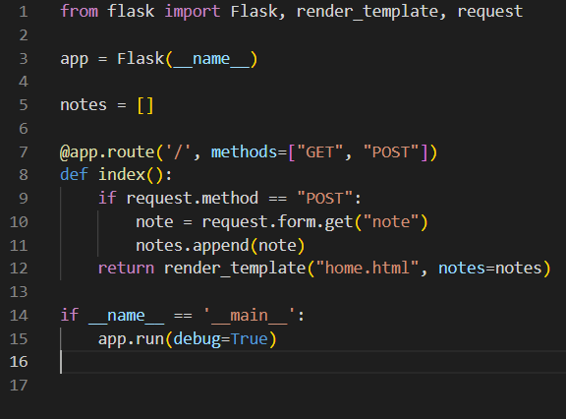
Flask application code
Route Method: In the Flask application, the route was defined for the root URL ('/'), but it only handled POST requests. To handle both GET and POST requests, we need to specify that in the route decorator.

Slide 5
Flask application code
Request Object: In the route function, the ‘request.args.get()’ method was used to retrieve the note from the form. However, for a POST request, form data should be accessed using ‘request.form.get()’

Slide 6
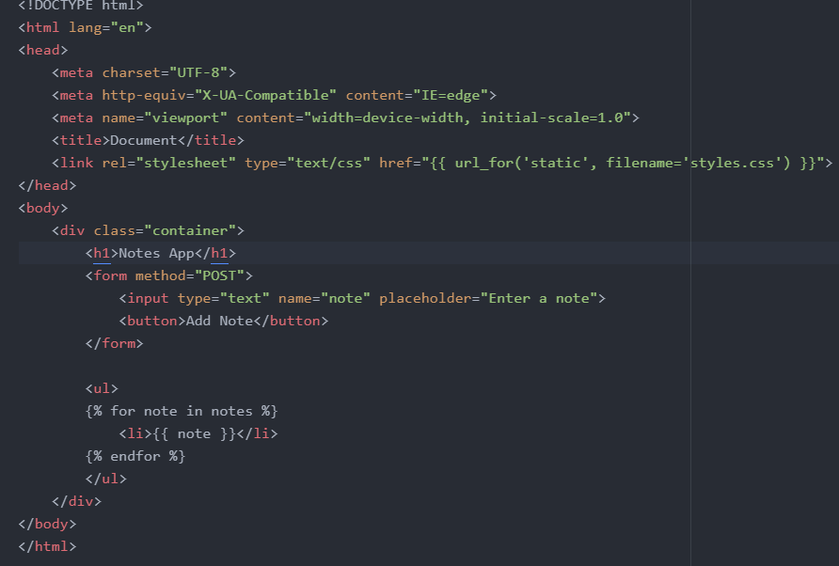
HTML
Form Method: In the HTML form, the ‘action’ attribute was empty. To make sure the form data is submitted to the Flask route correctly, it should be set to ‘POST’.

Slide 7
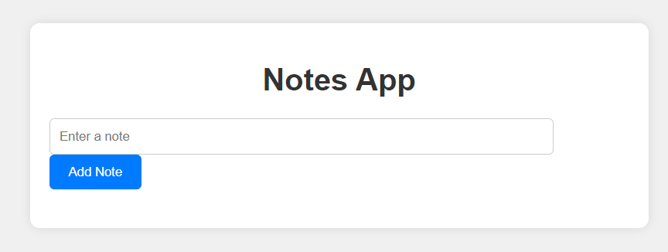
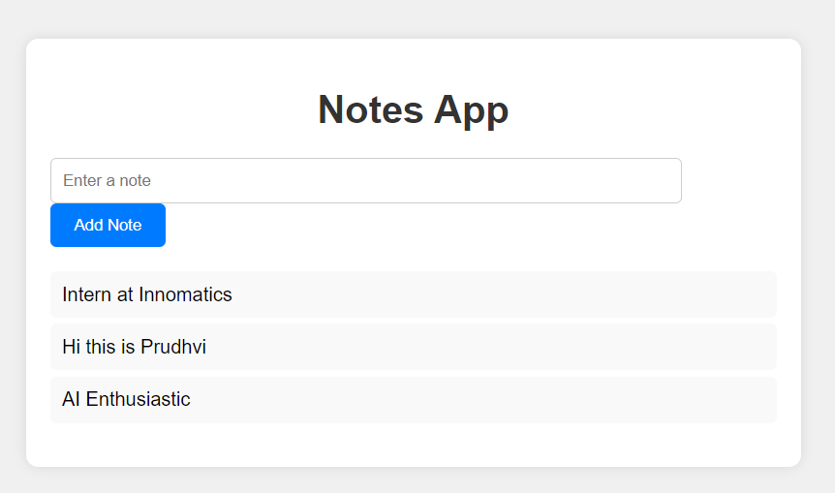
Note App

Slide 8

THANK YOU

